Slide 1

Binary Image Analysis
Binary images can be useful for numerous tasks
  Identifying objects in an image
  Recognizing text, symbols, drawings
  Determining orientations of objects in an image
Applications involve
  Text recognition (mail delivery, text-to-speech, etc..)
  Quality control systems in manufacturing systems
  Analysis of satellite imagery

Slide 2
Key Principles
Connectedness
Connectedness: how to determine whether two pixels are “connected”.
  Usually to determine if two pixels belong to the same component.
Two common definitions of connectivity
  4 connected and 8 connected
  A pixel is connected to P if both P and the pixel of interest X are both 1
X
X
X
X
X
P
X
X
P
X
X
X
X
X
4 connected
8 connected

Slide 3
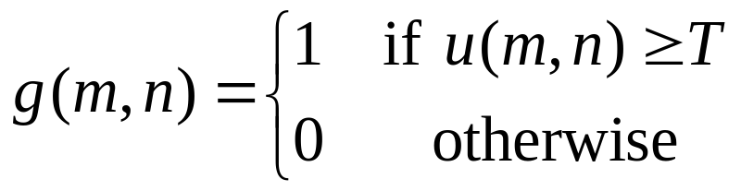
Thresholding
Global: Based on the intensities of the whole image. Thresholding creates binary images from gray-level ones by turning all pixels below some threshold to zero and all pixels above that threshold to one.
Local: Based on the intensities of a region of the image.

Slide 4
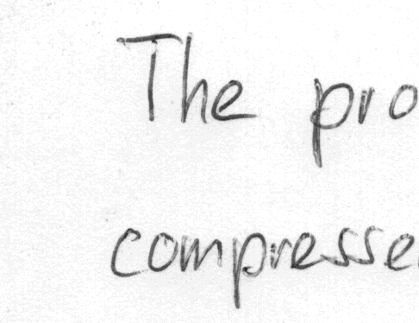
Thresholding
Given a gray-scale image, convert it to binary using thresholding. How to separate “objects” from “background”?
  Choose a threshold value of 128?

Slide 5
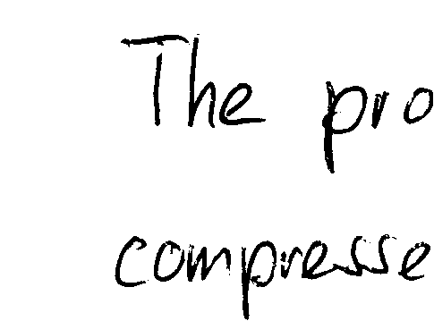
Adaptive Thresholding
Given a gray-scale image, convert it to binary using thresholding. How to separate “objects” from “background”?
  Choose a threshold value adaptively.

Slide 6




Adaptive Thresholding
Clustering (The Otsu method)
Consider the histogram distribution of an image is in the shape of two clusters. An appropriate threshold can be determined by making each cluster as tight as possible. We can adjust the threshold by increasing the spread of one and decreasing the other. The goal then is to select the threshold that minimizes the combined spread.
0
0
T
255
gray level

Slide 7
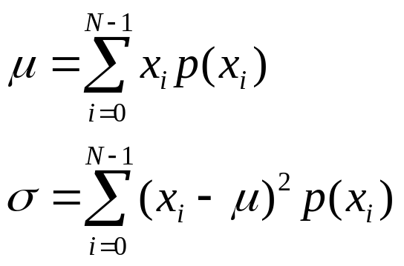
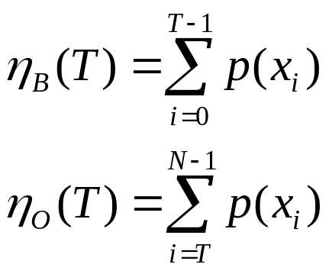

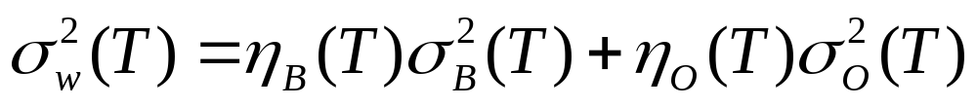
The Otsu method
T
0
0
255
gray level
Let define the within-class variance as the weighted sum of the variances of each cluster.
Between-class variance can be written as
The optimum threshold is the one that maximizes the between-class variance or, conversely, minimizes the within-class variance.

